Slide 1



K. J. Somaiya College of Engineering, Mumbai
(A Constituent College of Somaiya Vidyavihar University)
ANNFS IA1
Pattern Classification for Recognition of Handwritten Characters
Vedant Kelkar 1912052
Nachiket Naik 1912060

Slide 2

Real Life Applications
Where?
Reading support for the blind
Recording bank cheque numbers
Reading documents in academic institutes
Vehicle number plate recognition at toll booth
Validating signatures
How?
Feature extraction using Multilayer Feed Forward Neural Network
Character separation
Scaling of each character
Space detection
Line detection

Slide 3
Steps in implementation of HCR
Pre Processing
Denoising
Scanning and Skeletonization (reducing to thin lines)
Normalization (equal matrix dimensions)
Feature Extraction (boundary detection)
Segmentation, Scaling and Space detection
Neural Network Classification

Slide 4
Feature Extraction…
- Too much data, not much information
- Special form of dimensionality reduction
- Transforming the input data into the set of features
- Input data transformed into a reduced representation set

Slide 5
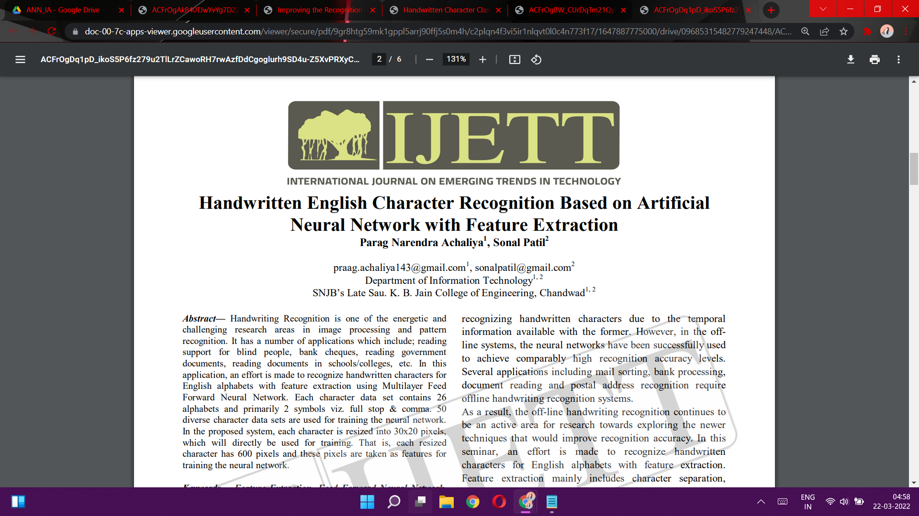
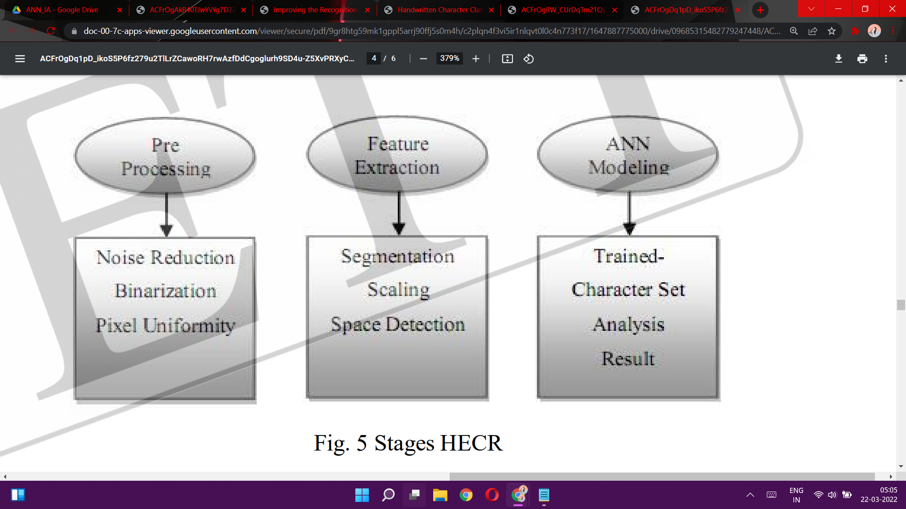
3 methods for HCR:
Single Voting
Multiple Voting
Class Distance

Slide 6
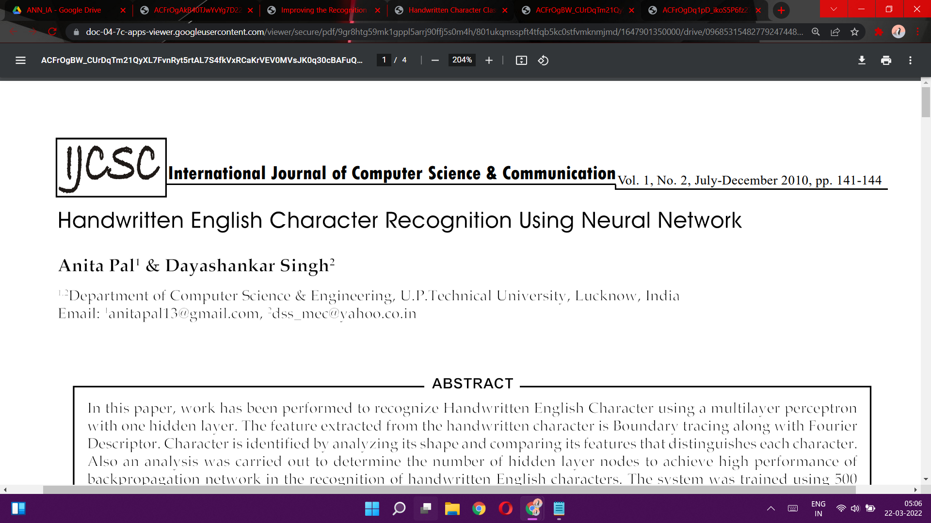
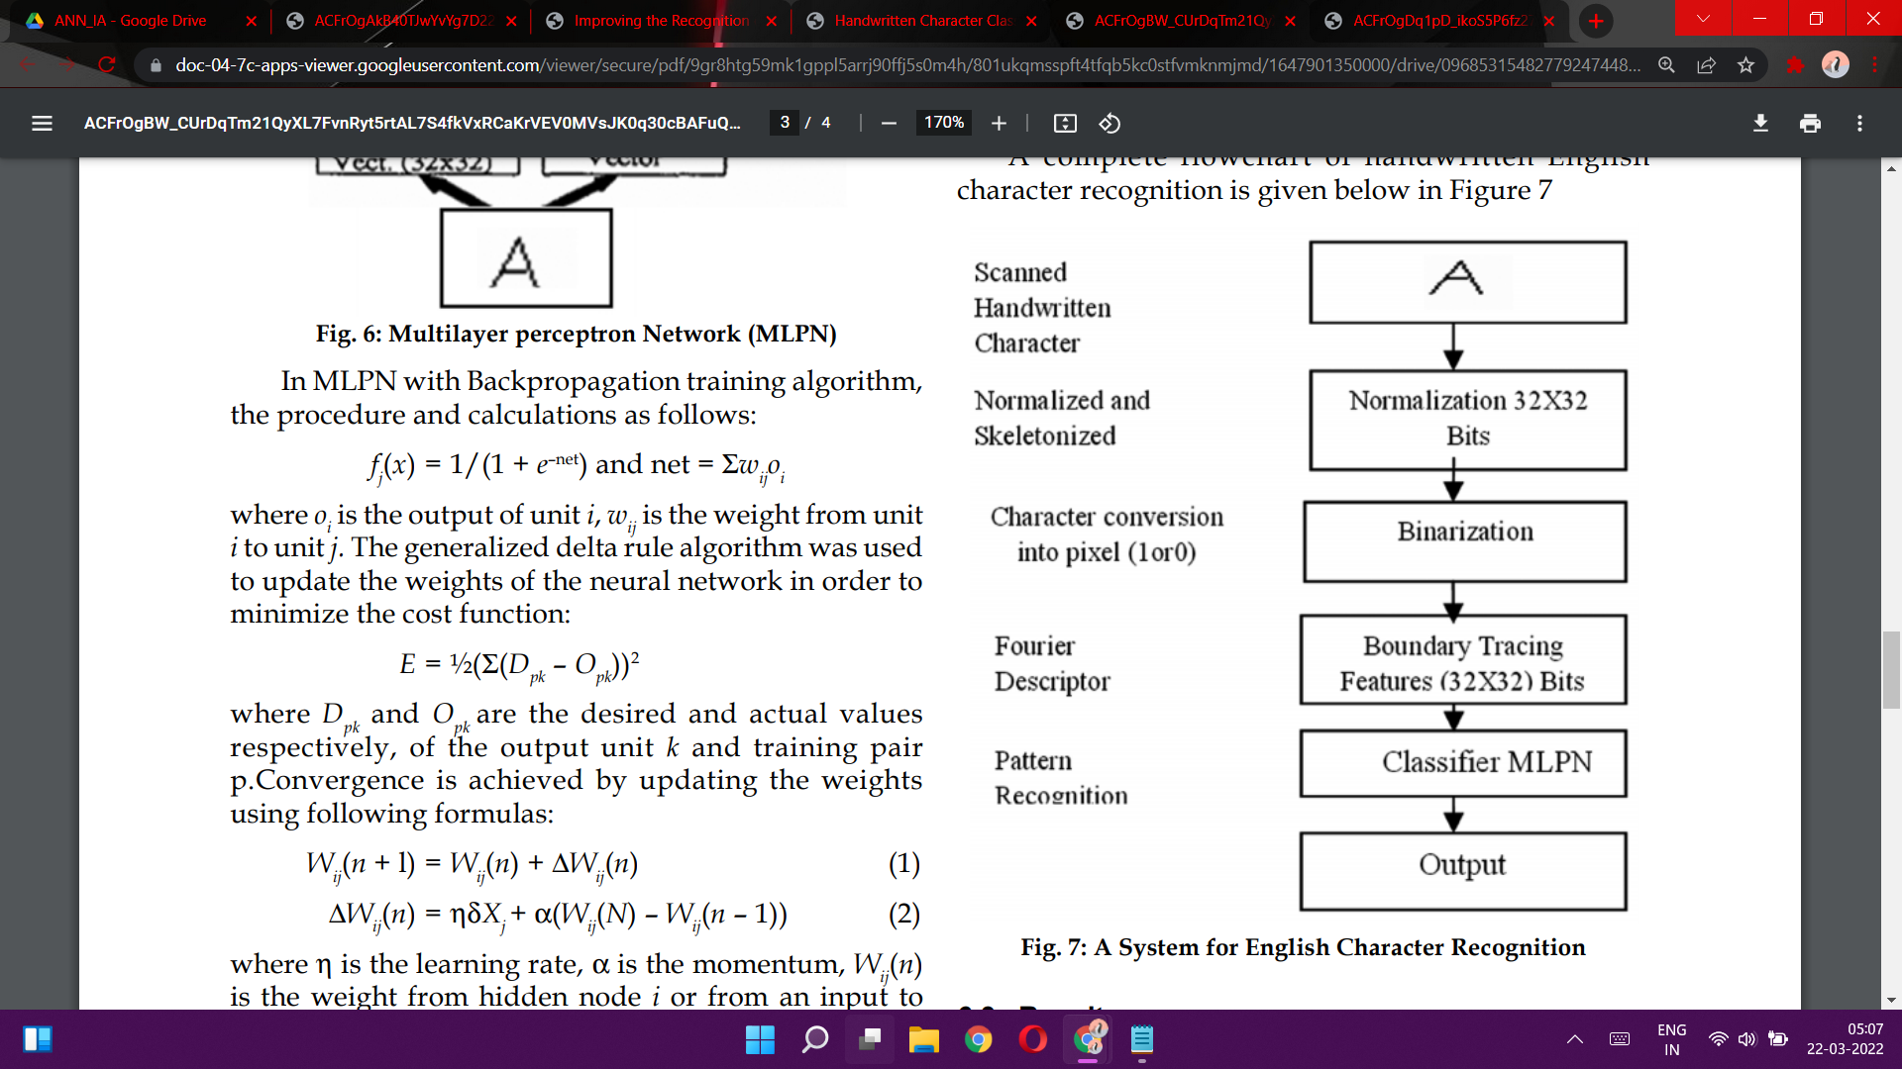
Feature extraction using 8 neighbour adjacent method (boundary detection)
Boundary coordinates are stored in an array to compute Fourier Descriptors

Slide 7
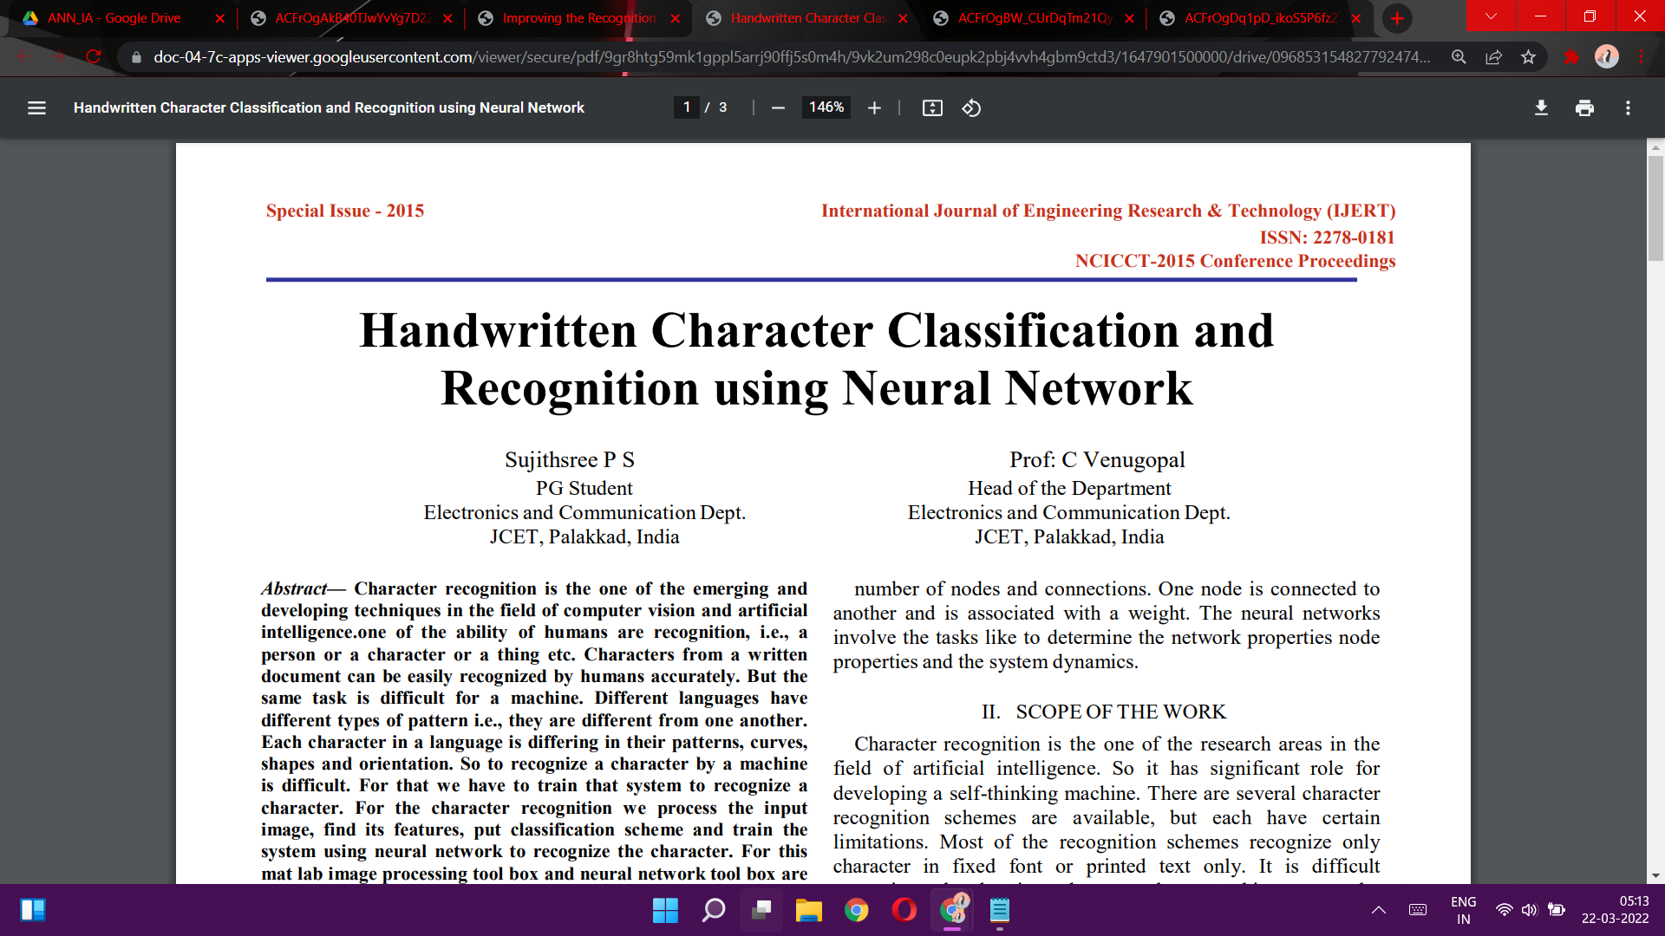
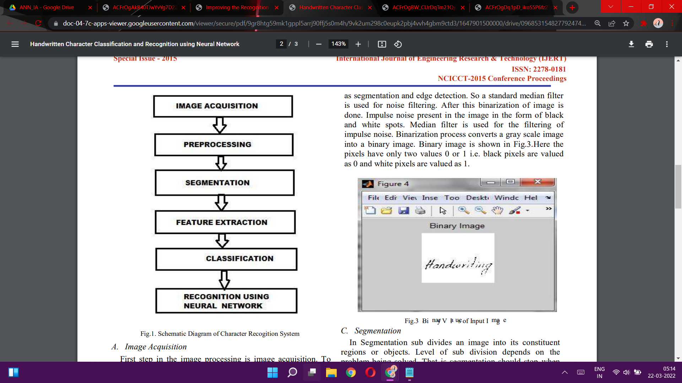
Segmentation
Dividing an image into its constituent regions or objects
Point, line & edge detection methods

Slide 8
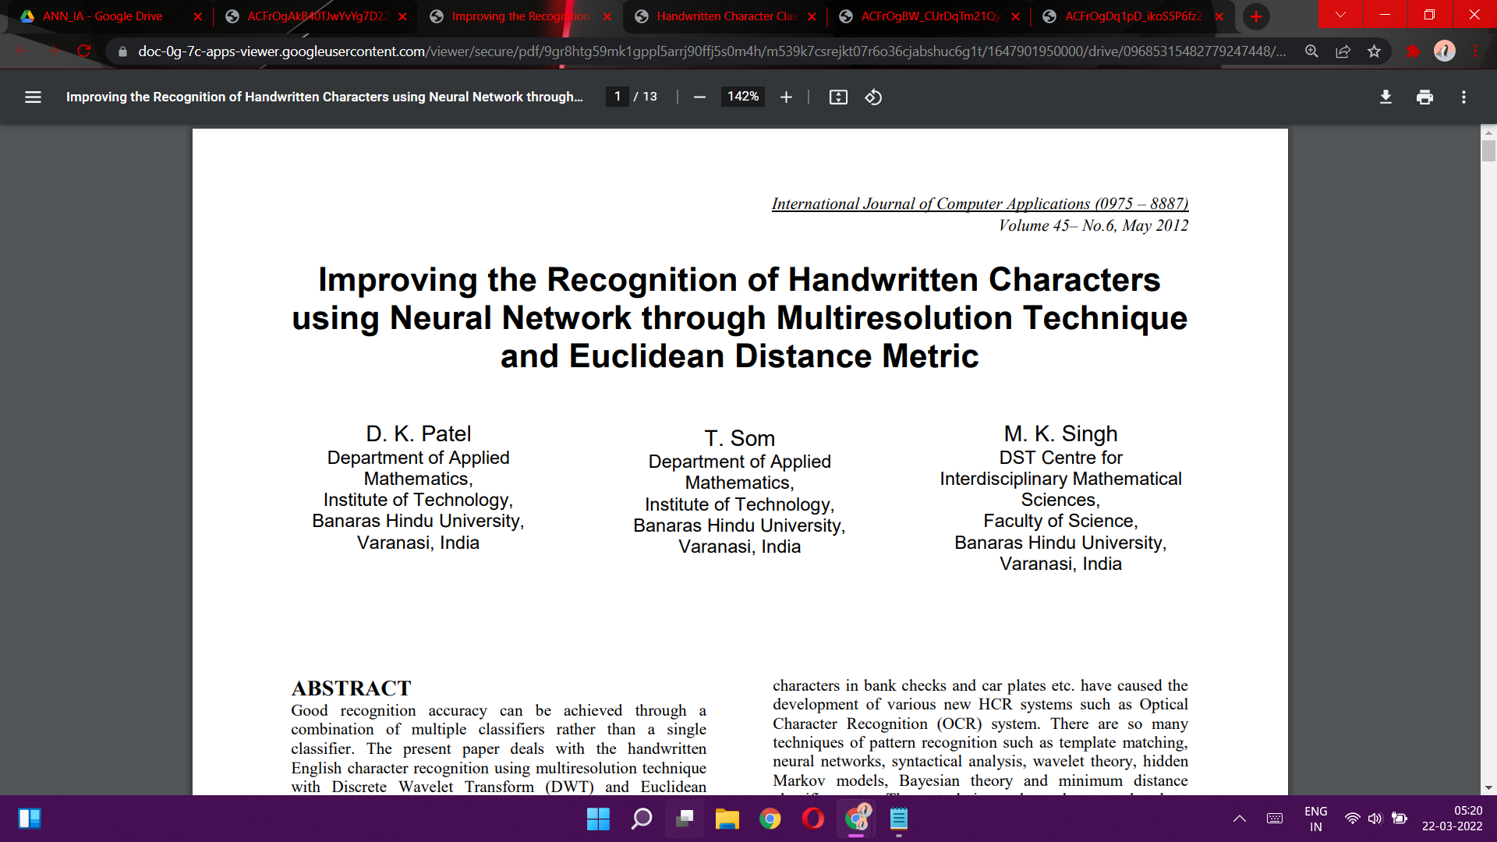
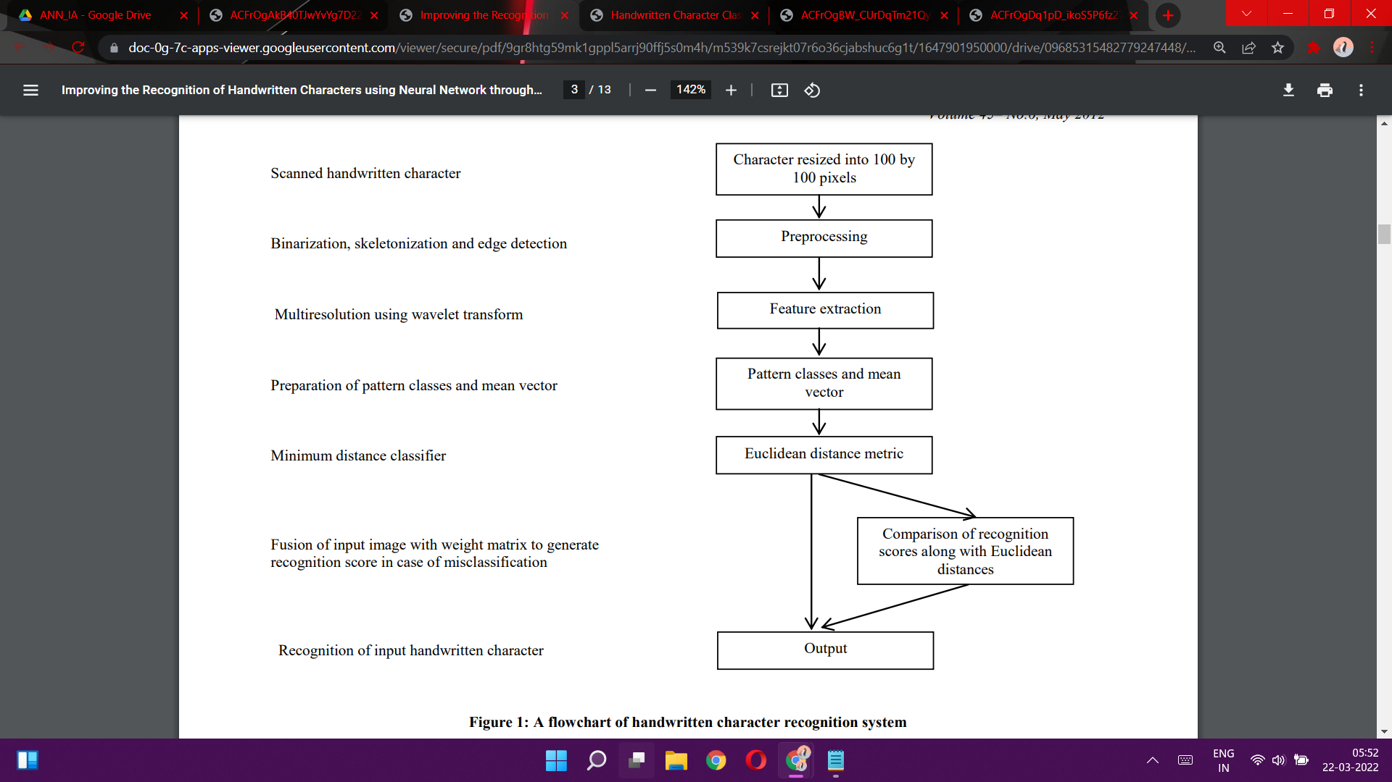
Feature extraction
Multiresolution using wavelet transform
Minimum Distance Classifier
Fusion of input image with weight matrix to generate recognition score in case of misclassification

Slide 9
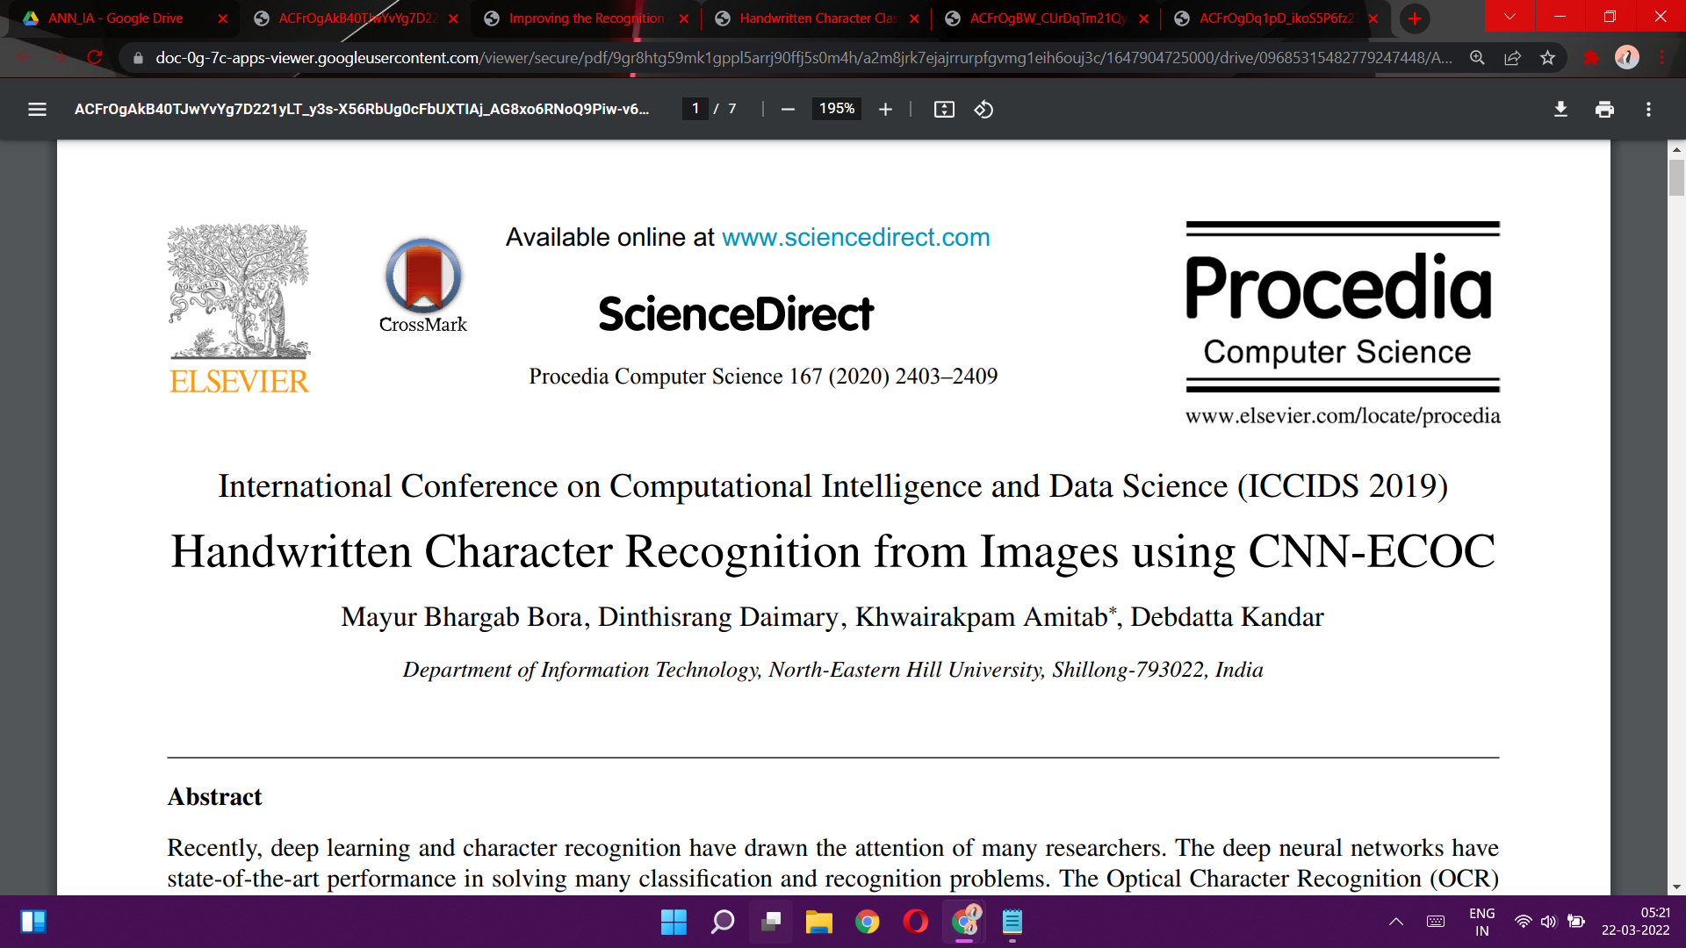
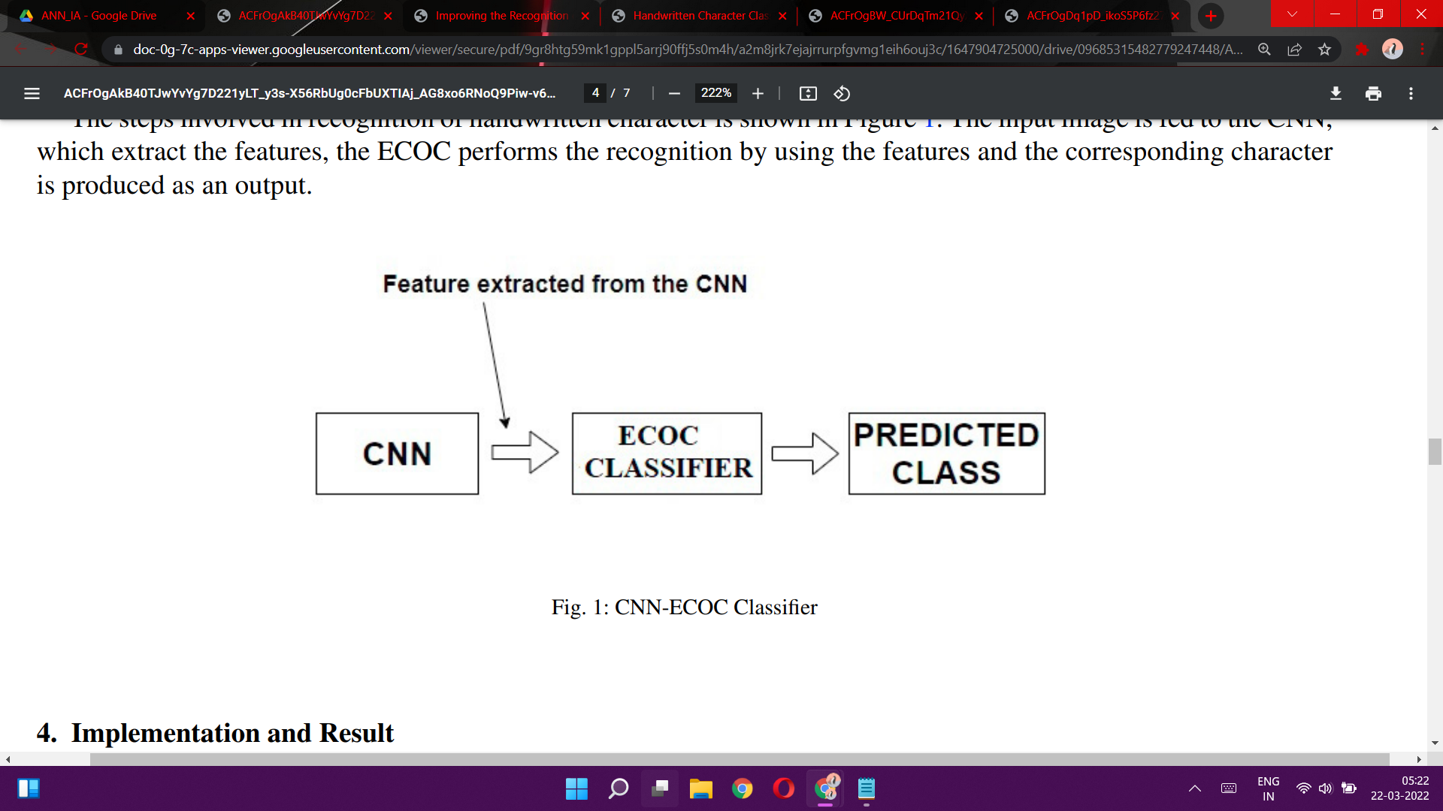
CNN for feature extraction and ECOC for recognition of characters
ECOC - Error Correcting Output Codes
Reframing multi-class classification problem to multiple binary classification problem
ReLU - activation function
Pooling layer
To reduce spatial size of each feature map
Min, avg and max pooling
Popular CNN Architectures:
AlexNet
ZfNet
LeNet

Slide 10
Future Scope
Electric form Filling
Automated music symbol notation reader
Solving handwritten mathematical equations
Biometrics and forensics

Slide 11
References …
D K Patel, T. Som, M.K Singh ‘Improving the Recognition of Handwritten Characters using Neural Network through Multiresolution Technique and Euclidean Distance Metric’
Mayur Bhargab Bora, Dinthisrang Daimary, Khwairakpam Amitab Debdatta Kandar'Handwritten Character Recognition from Images using CNN-ECOC’
Sujithsree P S, Prof: C Venugopal ‘Handwritten Character Classification and Recognition using Neural Network’
Anita Pal& Dayashankar Singh ‘Handwritten English Character Recognition Using Neural Network’
Parag Narendra Achaliya, Sonal Patil ‘Handwritten English Character Recognition Based on Artificial Neural Network with Feature Extraction’

Slide 12
THANK YOU!
Vedant Kelkar - 1912052
Nachiket Naik - 1912060

